Slide 1
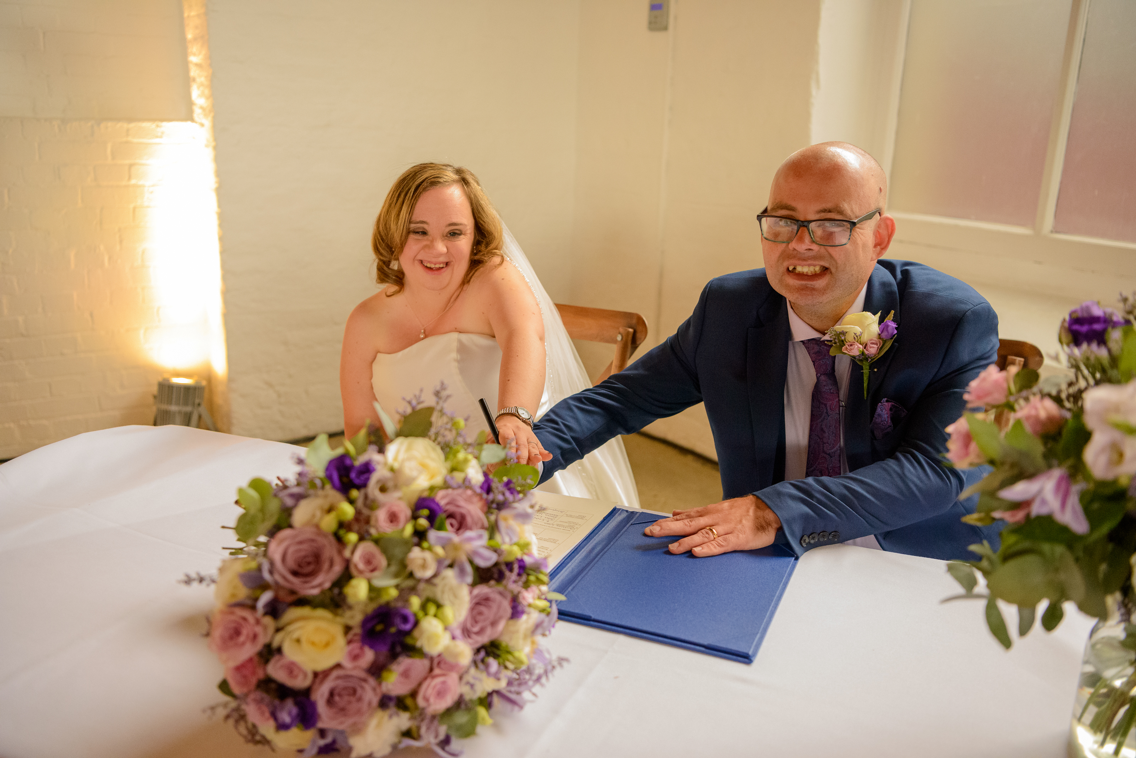
Ellen Goodey-Campbell
Hi, I’m Ellen. I am 43 and I live in East London with my husband Allan. We got married nearly four years ago.

Slide 2
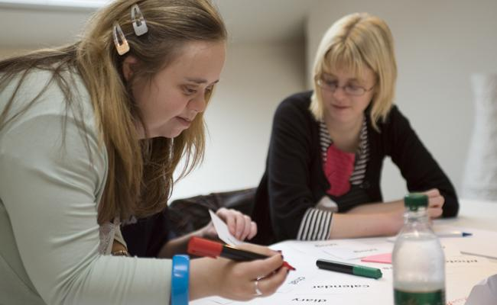
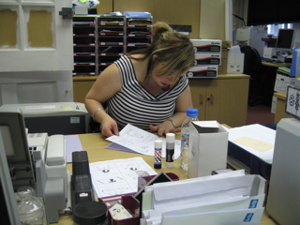
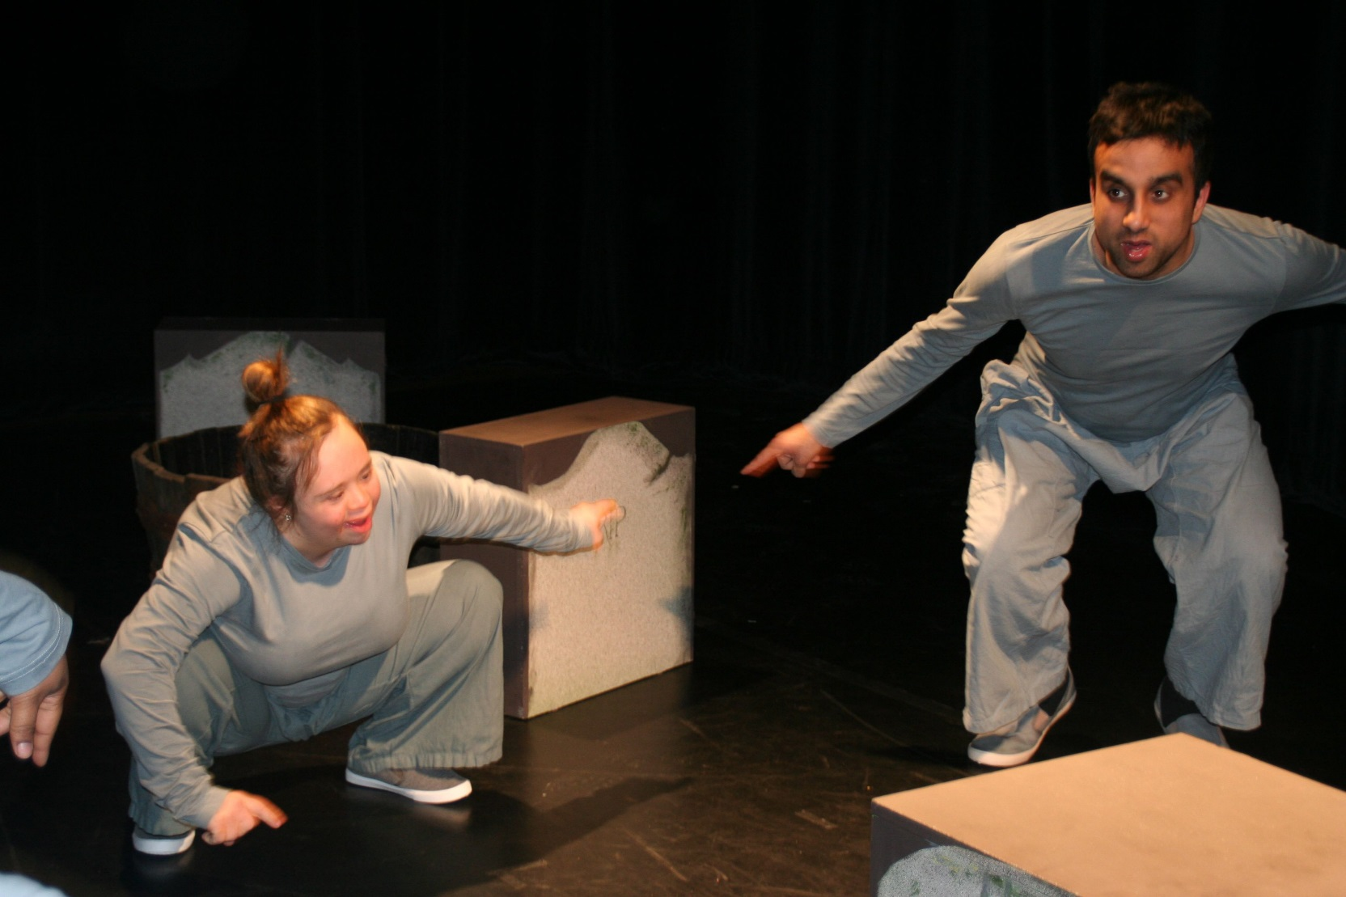
My work
I have three jobs:
I am a lived experience adviser for Mencap one day a week and teach on their drama course once a week
I work at the HQ of Knight Frank estate agents two days a week – I work front of house
I am also an actor. I am part of two theatre companies – Face Front Inclusive Theatre and Blue Sky Actors. We are touring in October till December

Slide 3
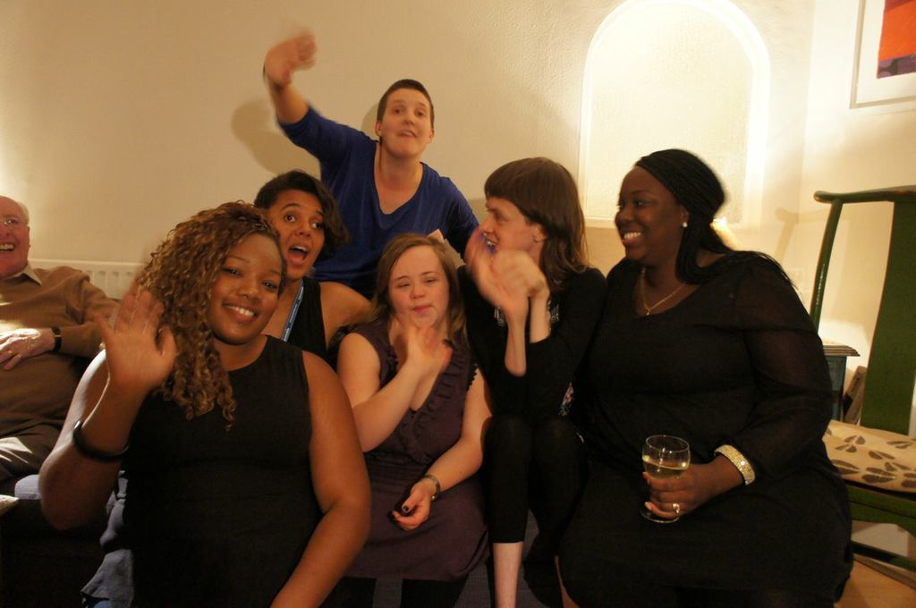
Outside of work
Allan and I go to the cinema, to the football, for walks and we see our friends
I still have “girly nights” and a holiday once a year
Allan and I like our holidays
I have known some of my friends since school

Slide 4
My support
My family live near me and support me
I have a PA called Kim
We go swimming twice a week
She helps with keeping the flat tidy and with the washing
We have a cleaner called Elena who comes once a week
Allan has a PA called Trish who is helping Allan with his work. She also cooks with us
I have to do lots of exercise to keep fit

Slide 5
School
I always invited my friends to my birthday parties and I went to theirs
Some of my friends came home to play
My teachers always knew how to
include me and my friends in everything
They knew how to make the lessons interesting and fun
I got 3 GCSE’s grades G and F and loads of other qualifications
I went to my local nursery, primary and secondary schools
These schools were inclusive and they were proud to have me as one of their students
My schools made sure that we all got along with each other and supported each other

Slide 6
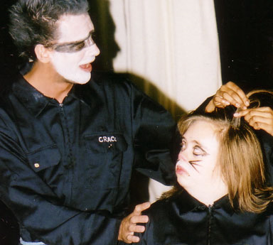
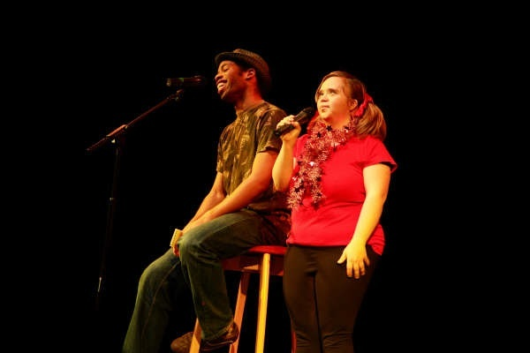
College
I started joining dance and drama groups when I was at school
My English teacher at secondary school knew that I loved writing and he encouraged me to write poems. I still love writing
My drama teacher worked with the head of performing arts at our local college
I did BTec in performing arts

Slide 7
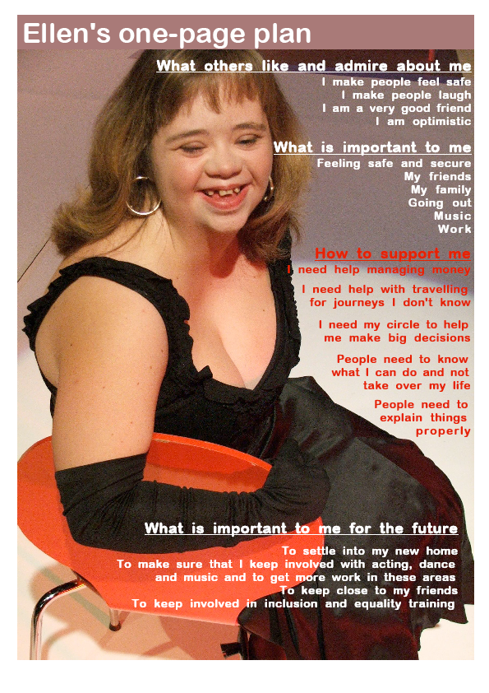
Conclusion
I was included in mainstream schools and colleges all the way
I’ve always had good support to have an ordinary life and not rely on “services” to do things
My family wanted me to have a good life
I use person-centred planning
My circle of support help me to achieve the things that are important to me.
This is a one-page profile

Slide 8
Thank you

