Slide 1
Living Experience – What matters to me

Slide 2
My Life, My Choices
Education that connect different life skills
My name is Harshi Gudhka
A sister, a friend, a volunteer
My Dream Jobs
My Independence
My Community

Slide 3
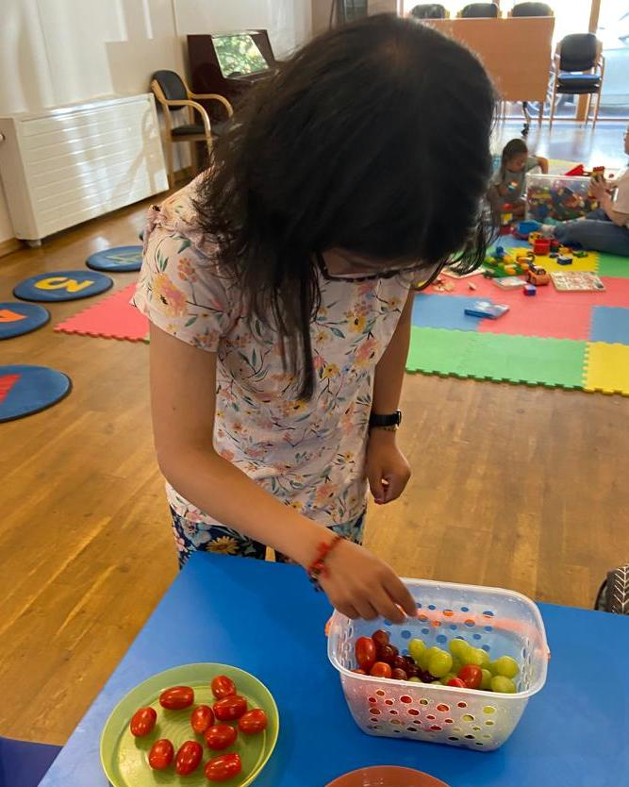
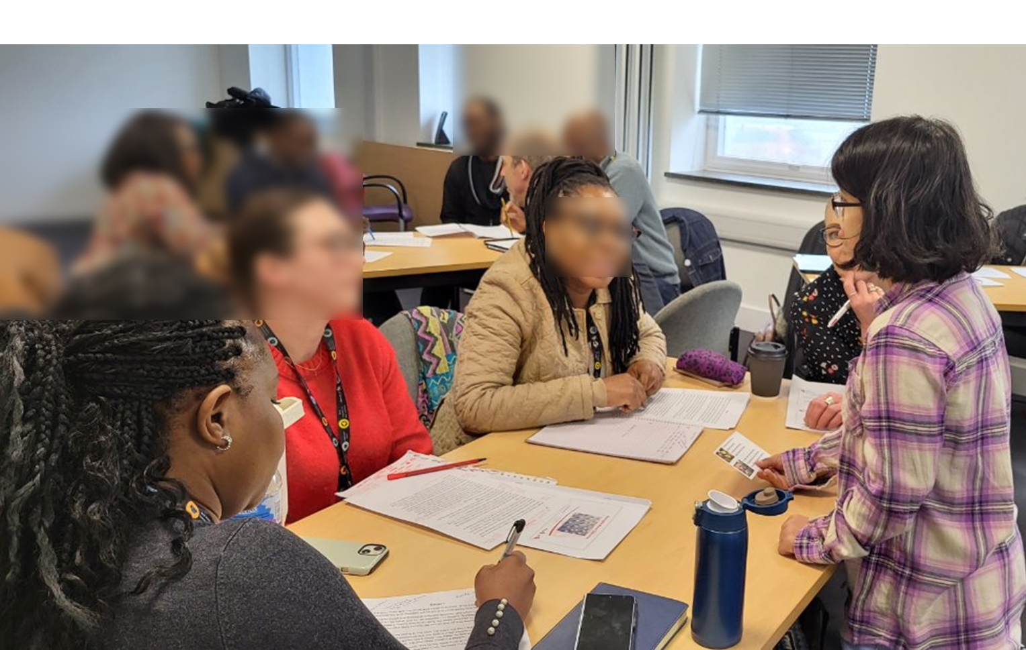
My Dream Job – focus on what I can do
Future: Working with younger children!
When I was younger: Volunteered at a Nursery and Downright Excellent
Now: I have 2 jobs:
  Co-Trainer for my Local Authority
  NHS Advisory Boards

Slide 4
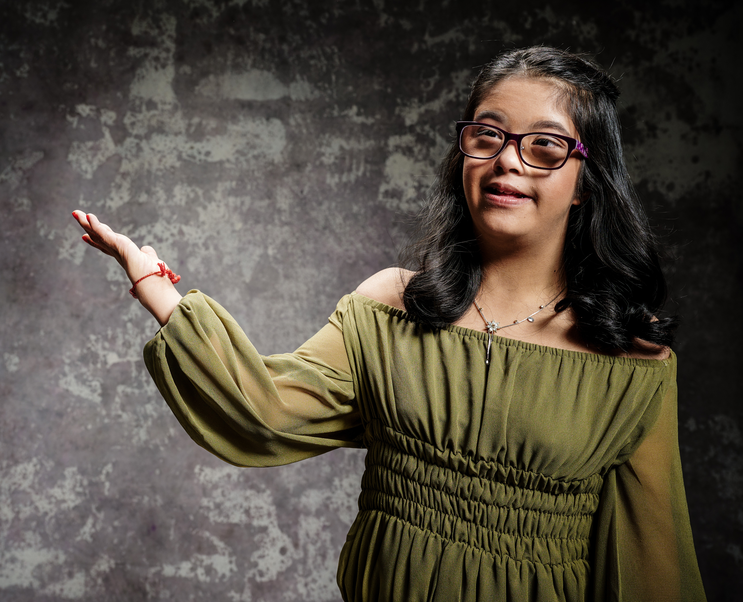
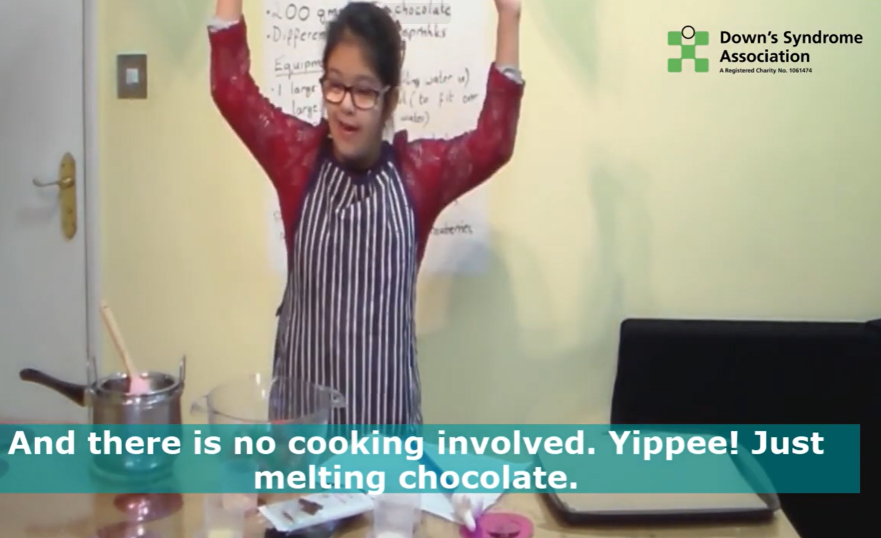
My Independence – and never alone
Having choices
Doing things by myself
Cooking Videos
Residential trips

Slide 5
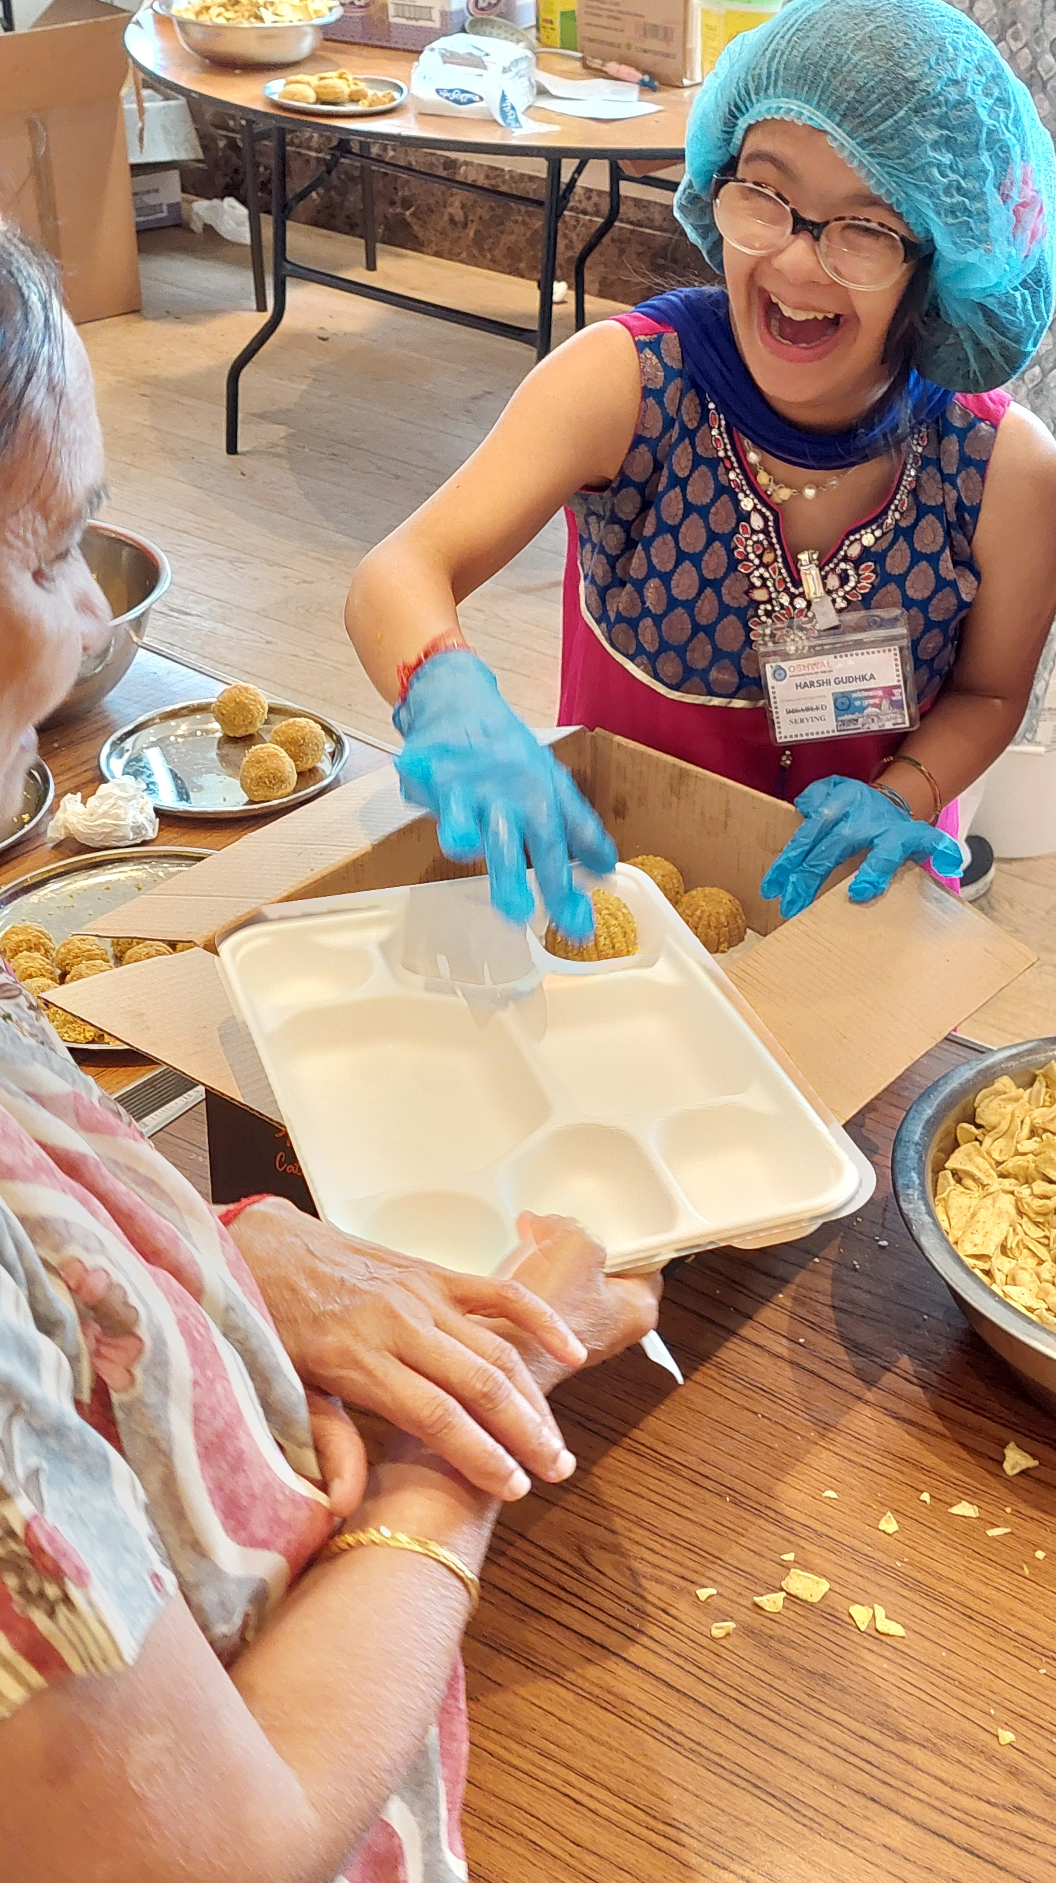
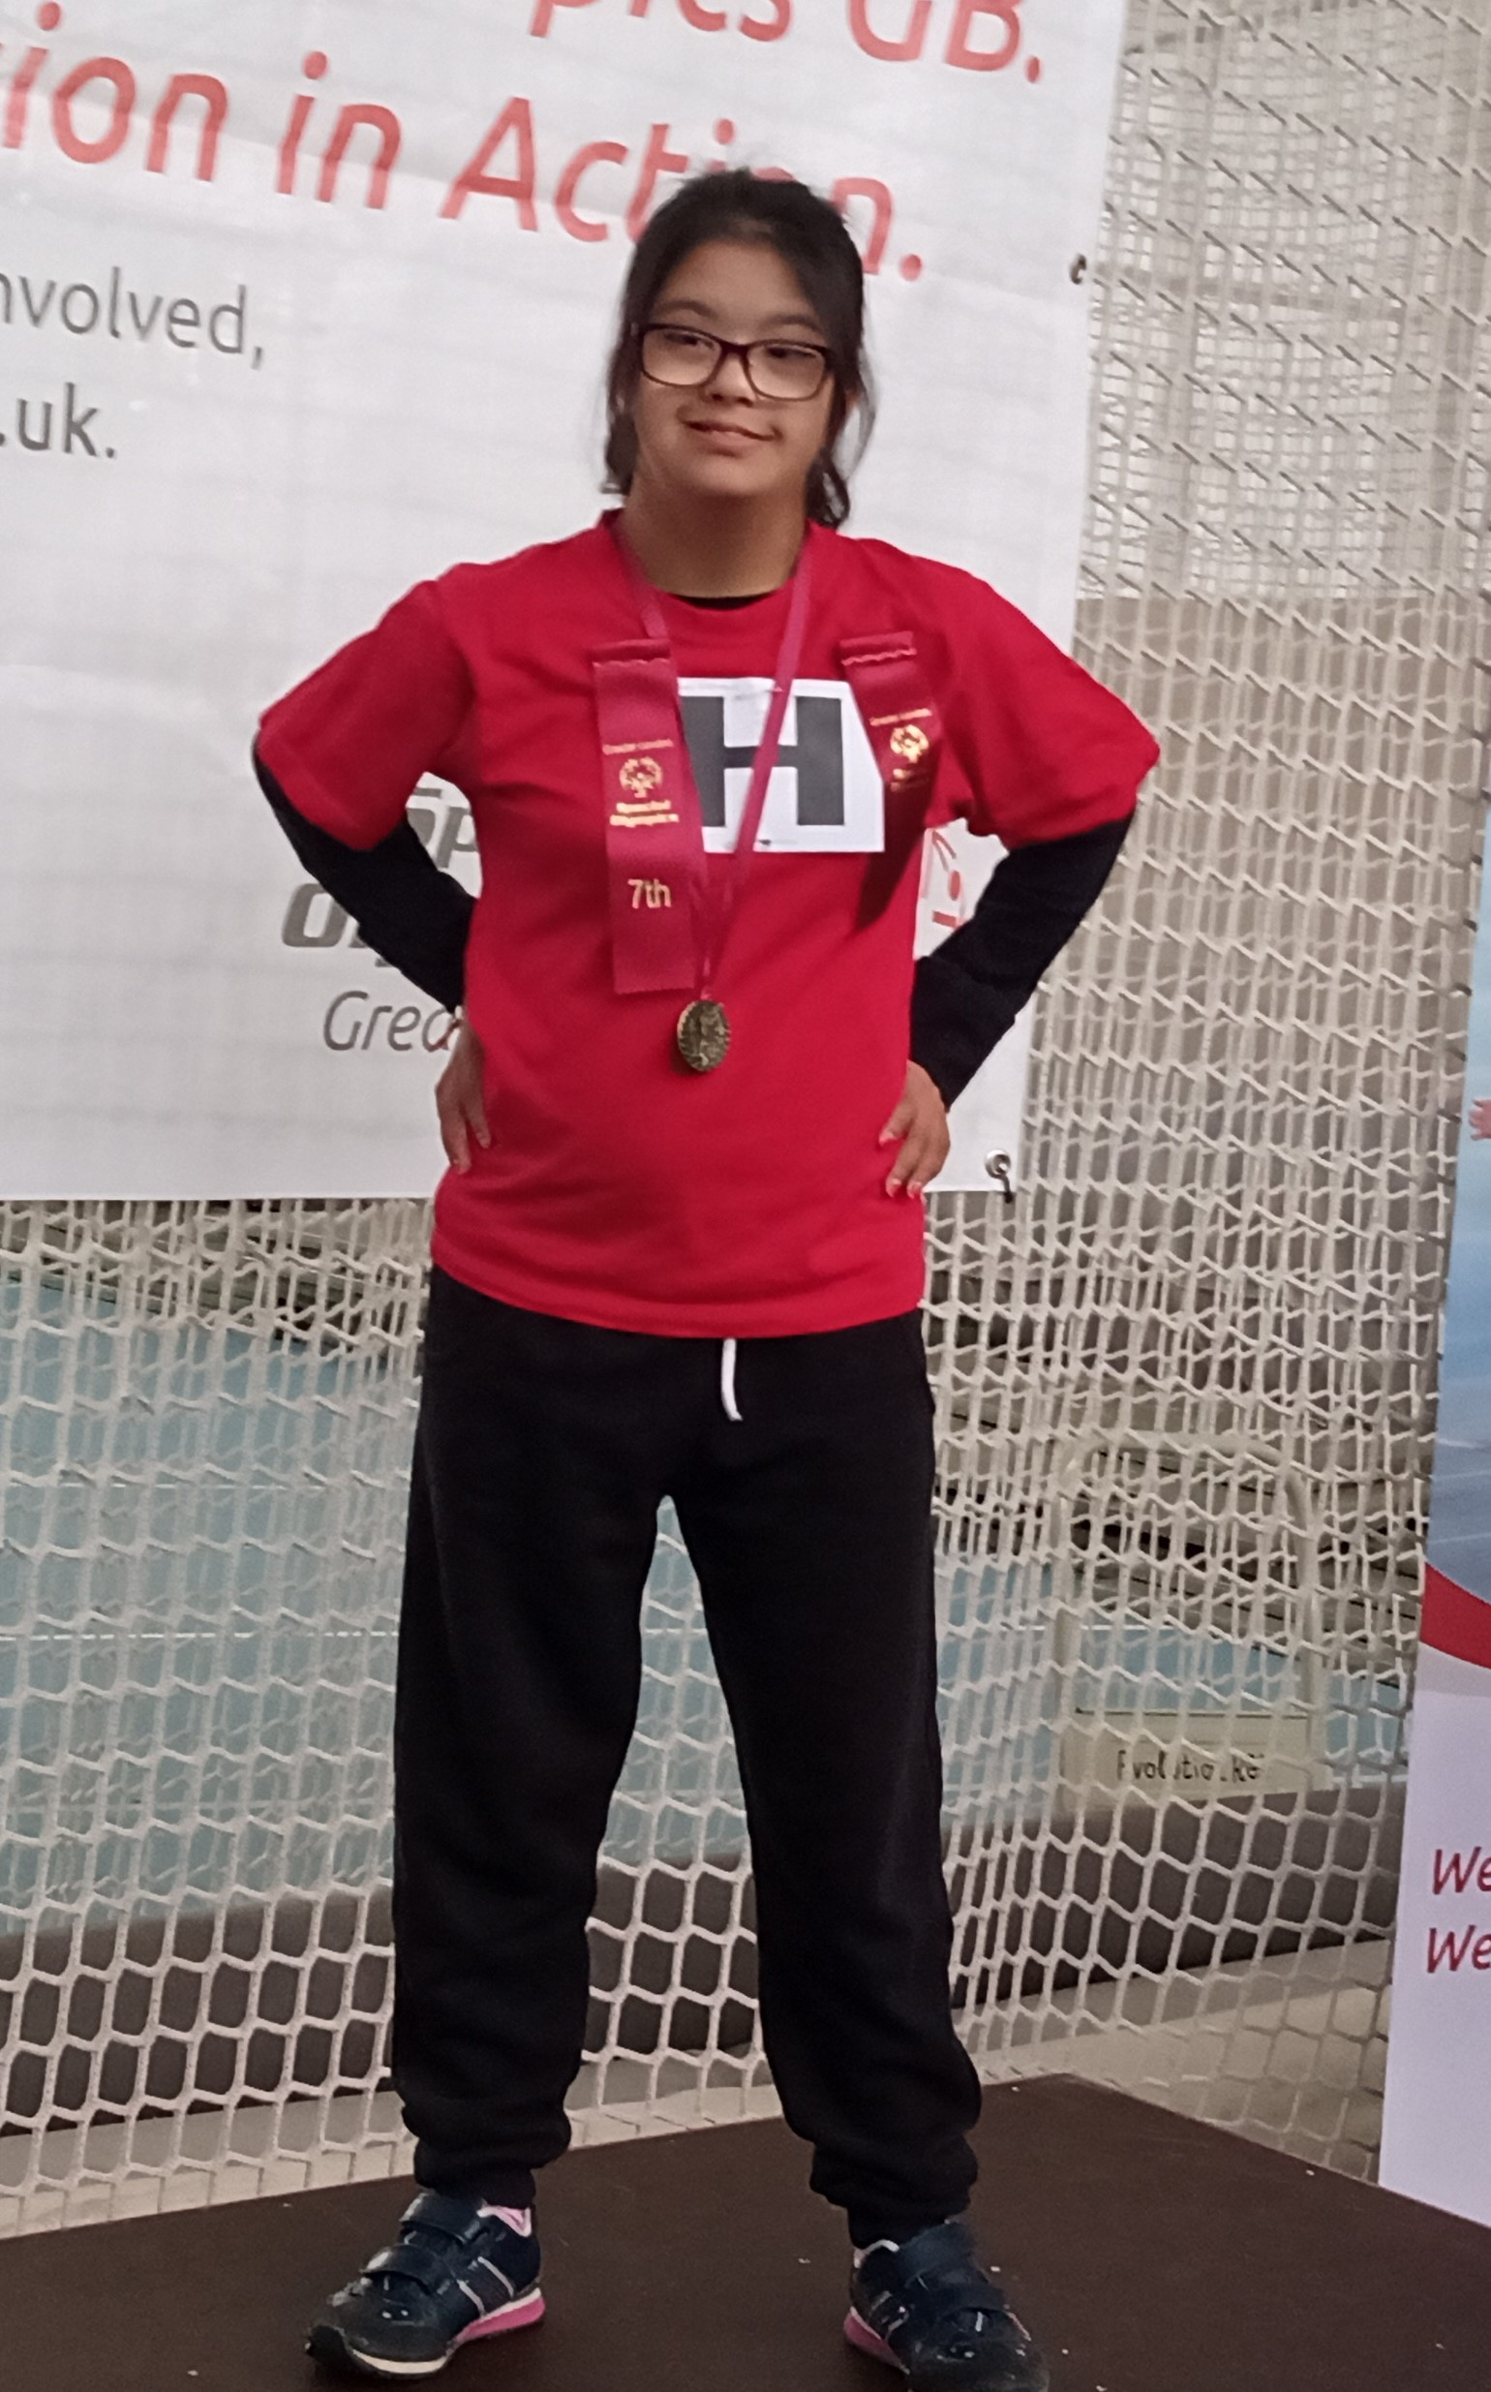
My Community – be included
Special Olympics and Swimming Competitions
Helping at our centre
Meeting New People

Slide 6

A connected education system will help me get to my future
.

