Slide 1



Away Days 2025: Collaboration
Ten years of ‘Preparing for Adulthood’
A retrospective overview – the legacy and implications for future policy
SEND Policy Research Forum

Slide 2

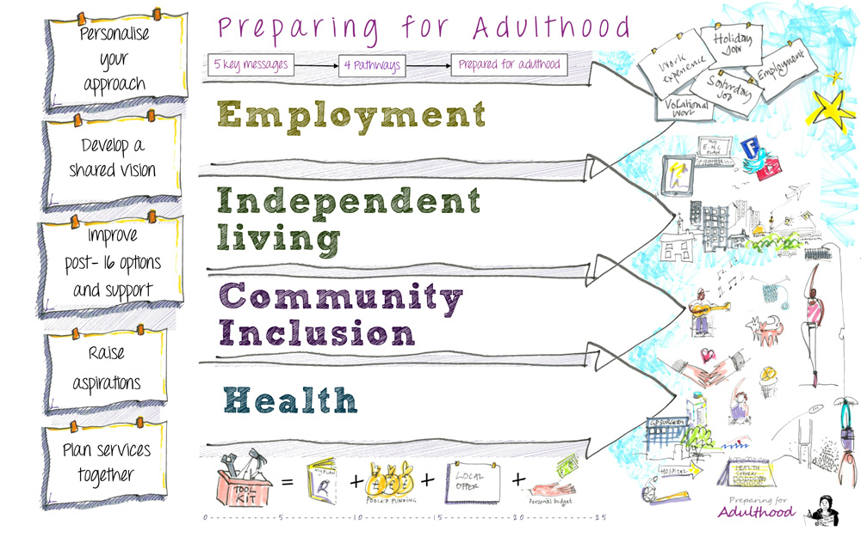
SEND Policy Research Forum

Slide 3
The Getting a Life Programme 2008-2011
400 young people living in 10 areas of England and their families and the people working in the SEND system
The young people were 14-25 and attended special schools
3 years of person-centred conversations to explore what was working and not working
Young people attending mainstream schools joined in in some of the areas
The messages were consistent in each area
Towards the end, the DfE officials visited some of the sites, met young people and families and asked us to help write chapter 8 of the SEND Code of Practice
The programme provided an evidence base of what was important to young people and what needed to change
Oldam, Manchester, North Tyneside, North-East Lincs, Torbay, Devon, Norfolk, Richmond, Hackney, Herefordshire
SEND Policy Research Forum

Slide 4
What the children and young people said
We want to feel like we belong
I have never been asked what I want to do when I leave education
Some people don’t use words to speak
doesn’t mean they don’t have feelings and ideas
We want to do what other people of our age do
I have never had careers advice
We are not listened to
Nobody believes we can work
Tell us what is possible
Nobody tells us anything about sex
We are not expected to have boyfriends, girlfriends or live with partners
Give us the information we need
Listen to us! (student forum/youth parliament)
We want friends and a social life
We need a proper education
We need proper sex education
SEND Policy Research Forum

Slide 5
The Preparing for Adulthood Programme
Funded by DfE
2012-2014 Pathfinders – trying out the new ideas
2014-2024 Funded to work with every local authority and to run regional networks
2024 – Funded to deliver PfA as part of the RISE, NASEN and ETF programmes
Also 2022-2026 The Internships Work programme
SEND Policy Research Forum

Slide 6
The Preparing for Adulthood Programme
Develop a vision across the whole system so that everyone knows what we want to see in 5 or ten years’ time
Person-centred practice
Locate all work within the social model of disability
Provide support, training and development so that everyone understands what they need to know about the impact of education has on young people’s lives as they move on
SEND Policy Research Forum

Slide 7
The Legacy
Almost everyone we work with and meet, think what the Code of practice says about Preparing for Adulthood is what they should be doing
Every local authority has a PfA strategy
All local offers have a lot of information about PfA and the four pathways
Some areas are doing some great work
We do very little work with Directors or Chief Executives in local authorities or the NHS
SEND Policy Research Forum

Slide 8
Barriers to achieving real change
The 2014 reforms landing in an environment which was beginning to experience fundamental changes in a different direction
Local authorities have been under pressure to implement and focus on bureaucracy rather than front line practice
The pressures have grown and we can see the outcomes of those pressures
Leaders having no space to development work or just dealing with the day to day and often crisis
The legacy of Eugenics
SEND Policy Research Forum

Slide 9
Implications for future policy
Very little mention of any of this in the White Paper and SEND Reforms
The Milburn Report shows that the current challenges for young people are not confined to children with SEND
There must be a change from high level buraecratic responses that are not evidence based to relational practice and a focus on environments the nurture children and young people and allow them to be who they reallya re, to find out what is important to them and
SEND Policy Research Forum

Slide 10



Thank you
https://www.ndti.org.uk/
lindajordan29@gmail.com
SEND Leadership

