Slide 1



Research into the social experience of adults with learning disabilities: what does this tell us about priorities for education?
Building Future Communities Research Centre | London South Bank University
Professor Nicola Martin

Slide 2
This presentation will cover:
Why research with adults with learning disabilities?
How to make research participation accessible.
Nothing About Us Without Us.
Research evidence relevant to education
Implications for practice

Slide 3
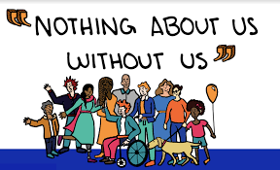
Why research with adults with learning disabilities?
Gerber and Reiff (2022). Limited research with adults who have learning disability . Focus on transition, education post school as key to employment and independence. Importance of perspective and retrospective.
Pupil /parent voice is an expectation of the Equality Act (2010), Children and Families Act (2014), Relevant UN Conventions and 2026 SEND white paper "Every child achieving and thriving
Dwerryhouse and Hall(2025). Parents views often predominate in research relevant to disabled children
Involving Disabled People in Social Research.

Slide 4
Why research with adults with learning disabilities?
Smith et al (2022) ‘Whilst all the individuals had positive experiences from attending special schools, a recurring negative theme is that of a pervading sense of low expectations.
Anderson (2023) ’Autistic self-advocates argue that applied behavior analysis damages their mental health and treats them as though they are a problem to be fixed’.
Horgan et al (2022) ‘Our analysis revealed that for many autistic young people, mainstream school is a complex and demanding social environment’.
Macdonald and Peacock (2026) ‘Both the education and youth justice systems in England and Wales are disabling and criminalising through processes that, often unintentionally; label, stigmatise, isolate, neglect and harm neurodivergent children.
Pearson et al (2026)‘Stigma associated with particular labels’.

Slide 5

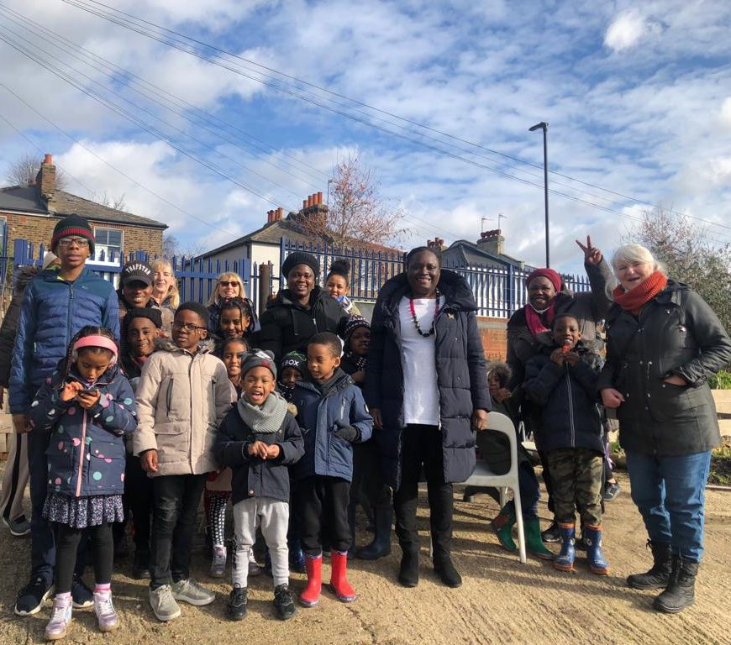
Why research with adults with learning disabilities?
Malone et al (2022): Abstract
Black autistic individuals, regardless of age, have not been centered in autism research. Instead, they often exist on the margins—on the periphery of autism research. In fact, Black autistic adults are largely absent from the literature. Most participants in autism research are majority-white autistic individuals and families. In this conceptual article, we use intersectionality and Dis/ability Studies and Critical Race Theory theories to contextualize Black autistic adults' experiences. Second, we argue that systemic disparities and methodological concerns are two contributors to the scholarly neglect of Black autistic adults in autism research. Third, we provide guidelines to support researchers in moving from neglect to inclusive research with Black autistic adults.
Home - autismvoice.org.uk
‘Children and families affected by Autism and other neurodevelopmental conditions are clogged in communities and societies beset by stigma and discrimination’.

Slide 6
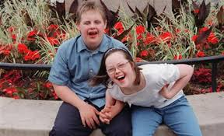



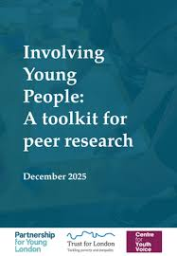

How to make research participation accessible
Engaging Critical Literacies, 2nd July
workshop with Partnership for Young London.
https://www.centreforthestudyof.net/digitalxdata/

Slide 7

How to make research participation accessible
PhotoVoice… combines photography and autobiographical narration, activating accessible expressive practices centred on subjectivity and lived experience. (Pistone et al 2026)
Photo-elicitation uses self-captured photographs to enhance verbal descriptions of complex concepts.(Lumina et al 2021)
Walking methodologies combine walking with verbal and non-verbal communication, such as body language or photography, and are particularly useful to study how children and young people relate to their environment, (Hammarsten 2025)
Photovoice: Seeing older adults’ physical and social health through their own lens - Active Aging Research Team

Slide 8
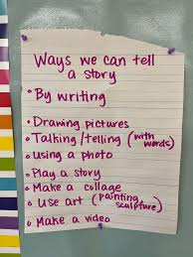
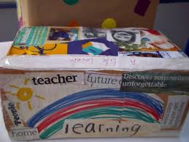
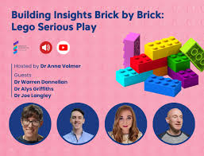
How to make research participation accessible
Lewis-Dagnell et al (2023)‘Multi-modal approaches that included photographs, symbols, video, observations, sign language, and adapted questionnaires. These methods were often deployed flexibly and shaped to meet the communication needs and preferences of the young people’.
Identity boxes. Lego. Object elicitation. I poems. Draw write tell. What else?
The Power of Accessing Writing Materials During Play | Writers Who Care

Slide 9
How to make research participation accessible
Martin et al 2019. The sensory school: working with teachers, parents and pupils to create good sensory conditions. Advances in Autism, 5(2), pp.131-140.
Brett, S.E., 2018. Pupils’ experiences of authentic voice and participatory practices in a special school . (Doctoral thesis LSBU
Hodgson-Jones (2026) How can schools better support pupils with dyslexia?). (Doctoral thesis LSBU)
Sturgess, S (in press) Use of social space by autistic students (Doctoral thesis in progress LSBU)
Knowing through doing: Insights from creative & embodied research
3 July https://knowing-through-doing-lsbu-ucl-2026.eventbrite.co.uk

Slide 10
Implications for practice
There is little research evidence from adults with learning disabilities looking back on their education
Minoritised communities and people excluded from education, training and employment are underrepresented
Parents and professionals often act as proxies for young people with learning disabilities
Creative approaches are essential in order to make research inclusive of eg people who do not read or speak English or use voice to communicate

Slide 11

Be aware of stigma associated with special education which can continue into adulthood
Intersectional factors are important
Cultural competence of practitioners
The tyranny of low expectations
Celebrating disability as a valued aspect of diversity
Nine factors that influence ‘belonging’ in school UCL National Children's Bureau Anti-Bullying Alliance education wellbeing children students secondary - SecEd

Slide 12

Research into the social experience of adults with learning disabilities: what does this tell us about priorities for education?

Slide 13
References
Anderson, L.K., 2023. Autistic experiences of applied behavior analysis. Autism, 27(3), pp.737-750.
Caslin, Marie. "We may be listening but are we ready to hear? A reflection of the challenges encountered when seeking to hear the educational experiences of excluded young people within the confines of the English education system." International journal of research & method in education 46, no. 1 (2023): 83-97.
Dwerryhouse, M. and Hall, L., 2025. Empowering Children: Ethical Decision-Making in Research Through a Strength-Based Approach.
Elder, B.C. and Migliarini, V., 2025. From Focus Group Discussion to Drawings. Humanizing Disability and Inclusive Education Research in the Global South, p.199-211.
Gerber, P.J. and Reiff, H.B., 2025. Speaking for themselves. University of Michigan Press.

Slide 14
Guedes, L.S., Zanardi, I., Mastrogiuseppe, M., Span, S. and Landoni, M., 2024, June. Scaffolding for inclusive co-design: supporting people with cognitive and learning disabilities. In International Conference on Human-Computer Interaction (pp. 151-170). Cham: Springer Nature Switzerland.
Hammarsten, M., 2025. A review of walk-and-talk conversations with children as a research method. Journal of Adventure Education and Outdoor Learning, 25(4), pp.1031-1047.
Horgan, F., Kenny, N. and Flynn, P., 2023. A systematic review of the experiences of autistic young people enrolled in mainstream second-level (post-primary) schools. Autism, 27(2), pp.526-538.
Kemps, L., 2022. Children with intellectual disabilities as interview participants.Jonkoping University MA thesis.
Lewis-Dagnell, S., Parsons, S. and Kovshoff, H., 2023. Creative methods developed to facilitate the voices of children and young people with complex needs about their education: A systematic review and conceptual analysis of voice. Educational Research Review, 39, p.100529.
Lumia, C.M., Arbour-Nicitopoulos, K.P., Moola, F.J. and McPherson, A.C., 2022. Using photo-elicitation to explore health promotion concepts with children and adolescents with disabilities: a rapid scoping review. Disability and Rehabilitation, 44(19), pp.5708-5718.
Macdonald, S.J. and Peacock, D., 2026. Dis/ableist criminology: Conceptualising the social harms experienced by neurodivergent individuals who have encountered the criminal justice system. The British Journal of Criminology, p.azag035.

Slide 15
Malone, K.M., Pearson, J.N., Palazzo, K.N., Manns, L.D., Rivera, A.Q. and Mason Martin, D.L., 2022. The scholarly neglect of black autistic adults in autism research. Autism in Adulthood, 4(4), pp.271-280.
Pistone, L., Pasqualetto, D. and Piccolo, A.L., 2026, May. PhotoVoice and Visual Narrative: A Pedagogical Perspective on Inclusion and Intellectual Disability. In Proceedings (Vol. 139, No. 1, p. 16). MDPI.
Pearson, A., Grant, A., Leigh, J., Macdonald, S.J., Williams, K., Williams, G., Spaeth, E., Rose, K., Memmott, A. and Botha, M., 2026. ‘It's like calling short people vertically challenged’: Language and terminology preferences among neurodivergent adults in the United Kingdom. Neurodiversity, 4, p.27546330261428235.
Sevón, E., Mustola, M., Siippainen, A. and Vlasov, J., 2025. Participatory research methods with young children: a systematic literature review. Educational review, 77(3), pp.1000-1018.
Smith, J., Lynes, M., English-Peach, C.M. and Sealey, C., 2023. Lived experiences of special schools in England: key considerations for social work practice. The British Journal of Social Work, 53(3), pp.1341-1351.
Wood, K., 2024. Can you hear us now? Adolescents share their experiences of mental health services using photo, sound and object elicitation (Doctoral dissertation, City, University of London).

Slide 16


